Slide 1
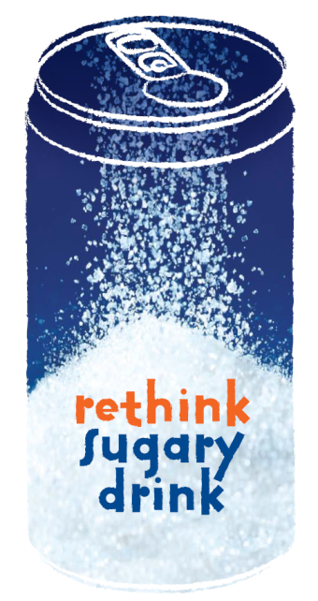
Rethink Sugary Drink
Insert workplace logo here

Slide 2
What is a sugary drink?
A drink with high levels of sugar – e.g. soft drinks, energy drinks, fruit drinks, iced teas and sports drinks
To give you an idea, a regular 600mL bottle of soft drink contains around 16 teaspoons of sugar!
Video: Rethink Sugary Drink
Notes:
What is a sugary drink?
A drink with high levels of sugar – this includes soft drinks, energy drinks, fruit drinks, iced teas and sports drinks
To give you an idea of just how much sugar is in some of these drinks, a regular 600mL bottle of soft drink contains around 16 teaspoons of sugar!
As this video shows, you’d never eat 16 packets of sugar, so why drink it?!
Play video

Slide 3
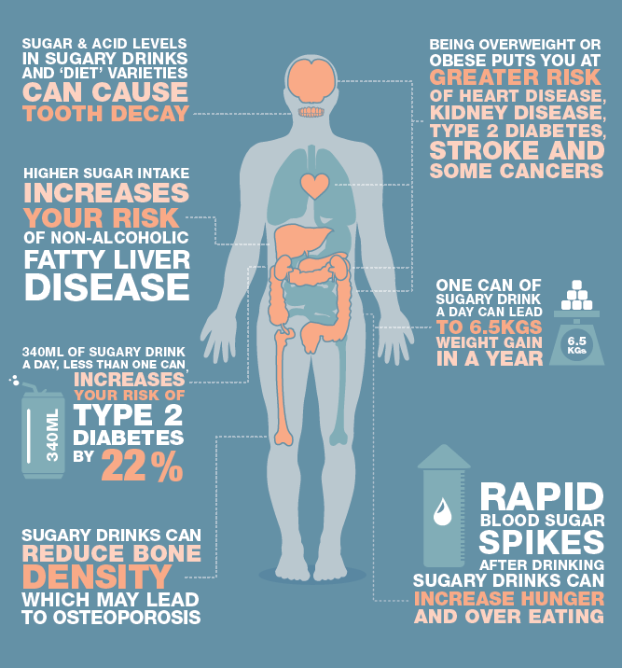
Sugary drinks & your body
Regular consumption can lead to weight gain and obesity
This increases the risk of type 2 diabetes, heart disease, kidney disease, stroke and some cancers
Sugary drinks can also lead to tooth decay
Notes:
As you can see from this graphic, regularly consuming sugary drinks can lead to a number of serious health issues.
All of the excess sugar that we consume from sugary drinks can lead to weight gain and obesity, which are major risk factors for serious health problems including type 2 diabetes, heart disease, kidney disease, stroke and some cancers.
Sugary drinks can also lead to tooth decay.

Slide 4
Sugary drinks & your body
Video: Man Drinking Fat
Notes:
Because sugary drinks are so high in sugar and kilojoules, just one can of soft drink a day can make you at least 5kg fatter in a year!
Play video

Slide 5
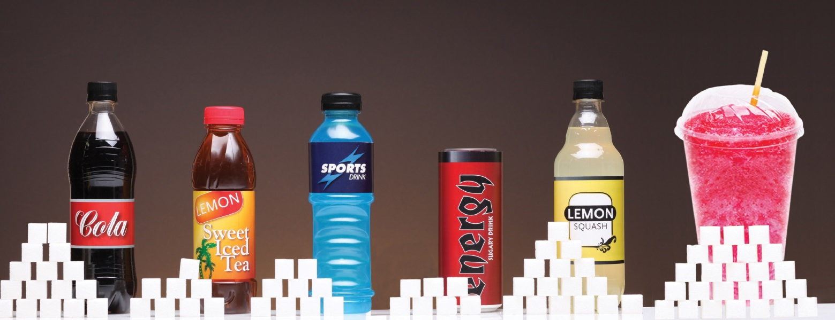
How much do we drink?
1 in 3 Australians consume sugar-sweetened drinks on any given day
Just one can of sugary drink a day can make you at least 5kg fatter in a year!
Some young men aged 19-30 years consume 1.5L per day!
Notes:
How much do we drink?
Too much!
Around one third of people aged 2 and over drink a sugar-sweetened beverage including soft drink, energy drinks, fruit drinks and cordial on any given day.
Just one can of sugary drink a day can make you at least 5kg fatter in a year! Some young men aged 19-30 years are consuming a staggering 1.5L per day.

Slide 6
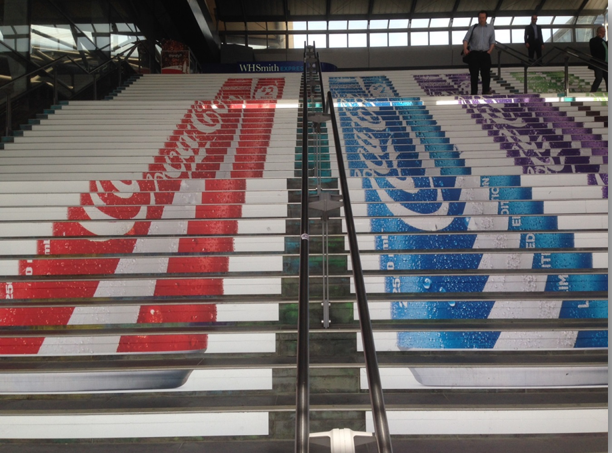
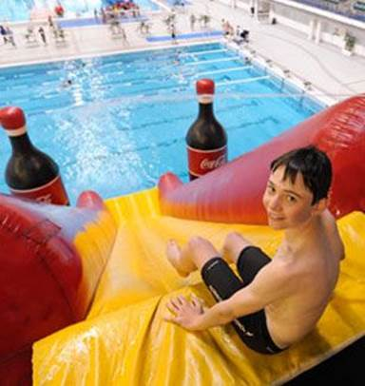
Why do we drink them?
The sweet taste has us hooked
They are excessively advertised & available everywhere
They’re cheap!
Notes:
So why do we drink them?
Sugary drink brands such as Coca Cola, Gatorade and Red Bull have invested a lot of time and research into making products that taste good and have us coming back for more.
What’s more, they’ve ingrained themselves into our lives – we see sugary drinks being sold and advertised everywhere from train stations and football stadiums to hospitals, shopping centres and even schools.
To give you an indication, Coke reportedly spent $3.3 billion on advertising in 2013.
Entire aisles are dedicated to them at the supermarket, venues and workplaces have vending machines packed with them, and they are often cheaper than bottled water.
And sometimes these drinks are cheaper than water.
Sugary drinks are hard to avoid!

Slide 7
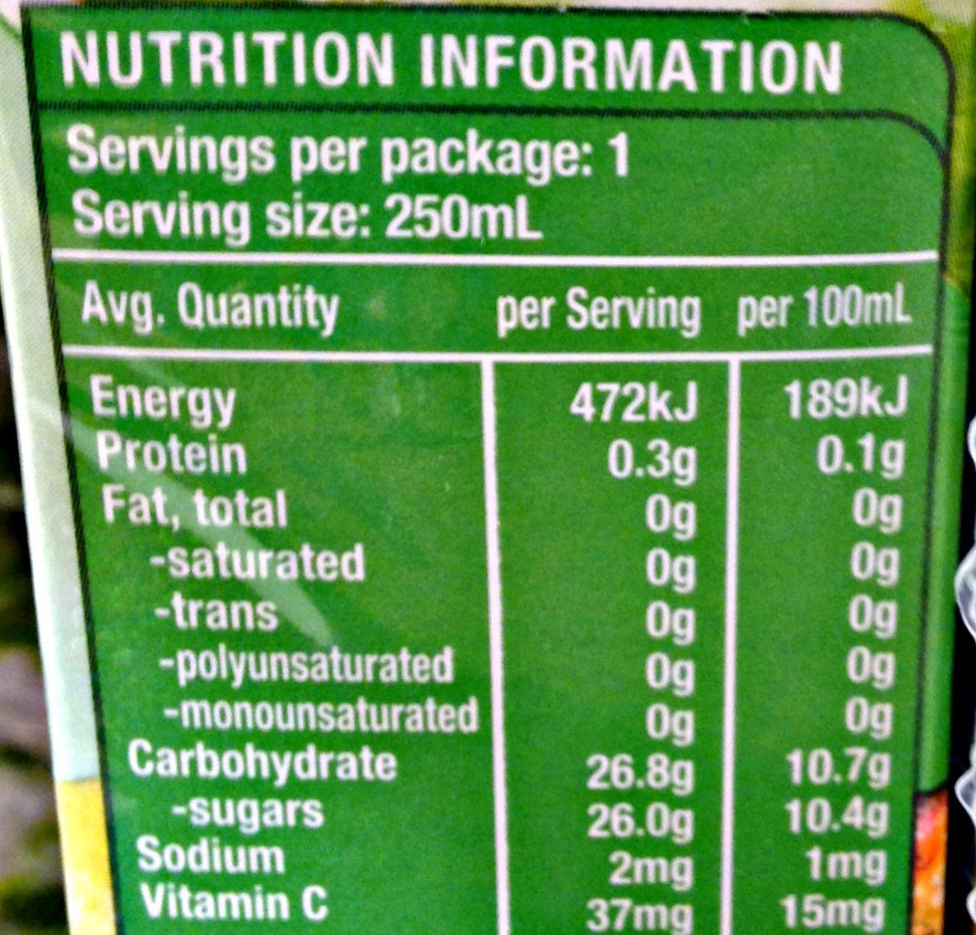
How can I cut back?
Check how much sugar is in your favourite drink at www.rethinksugarydrink.org.au
Be wary of health or nutrition claims on drinks – check the sugar content on the nutritional panel
If you're ordering a fast food meal, ask for water instead
Carry a water bottle
If you're thirsty, have some water first
Avoid soft drink aisle in supermarkets & beware of specials at service stations, etc.
Notes:
How can you reduce your sugary drink intake?
Here are some tips:
Find out how much sugar is in your favourite drink on the ‘how much sugar is in…’ page on the Rethink Sugary Drink website – or checking the nutrition panel on the bottle or can. See the image on screen for where to look for sugar content. Bear in mind that 4g = 1 teaspoon!
If you're ordering a fast food meal, don't go with the default regular/sugar soft drink, see what other options there are. For kids, see what else is on offer, or just ask for water.
Carry a water bottle, so you don't have to buy a drink if you're thirsty.
If you're thirsty, have some water first.
Be wary of any health or nutrition claims on the drinks you buy. Many producers are now trying to make their sugar sweetened beverages sound healthier than they actually are. Refer to the amount of sugar on the nutrition panel if in doubt and consider the size of the bottle as well.
If you consume sugary alcoholic drinks, see if there are lower sugar options. Even alcohol alone is loaded with kilojoules so cutting back on the booze is also good.
Try to avoid going down the soft drink aisle at the supermarket and beware of the specials at the checkout and the service station.

Slide 8
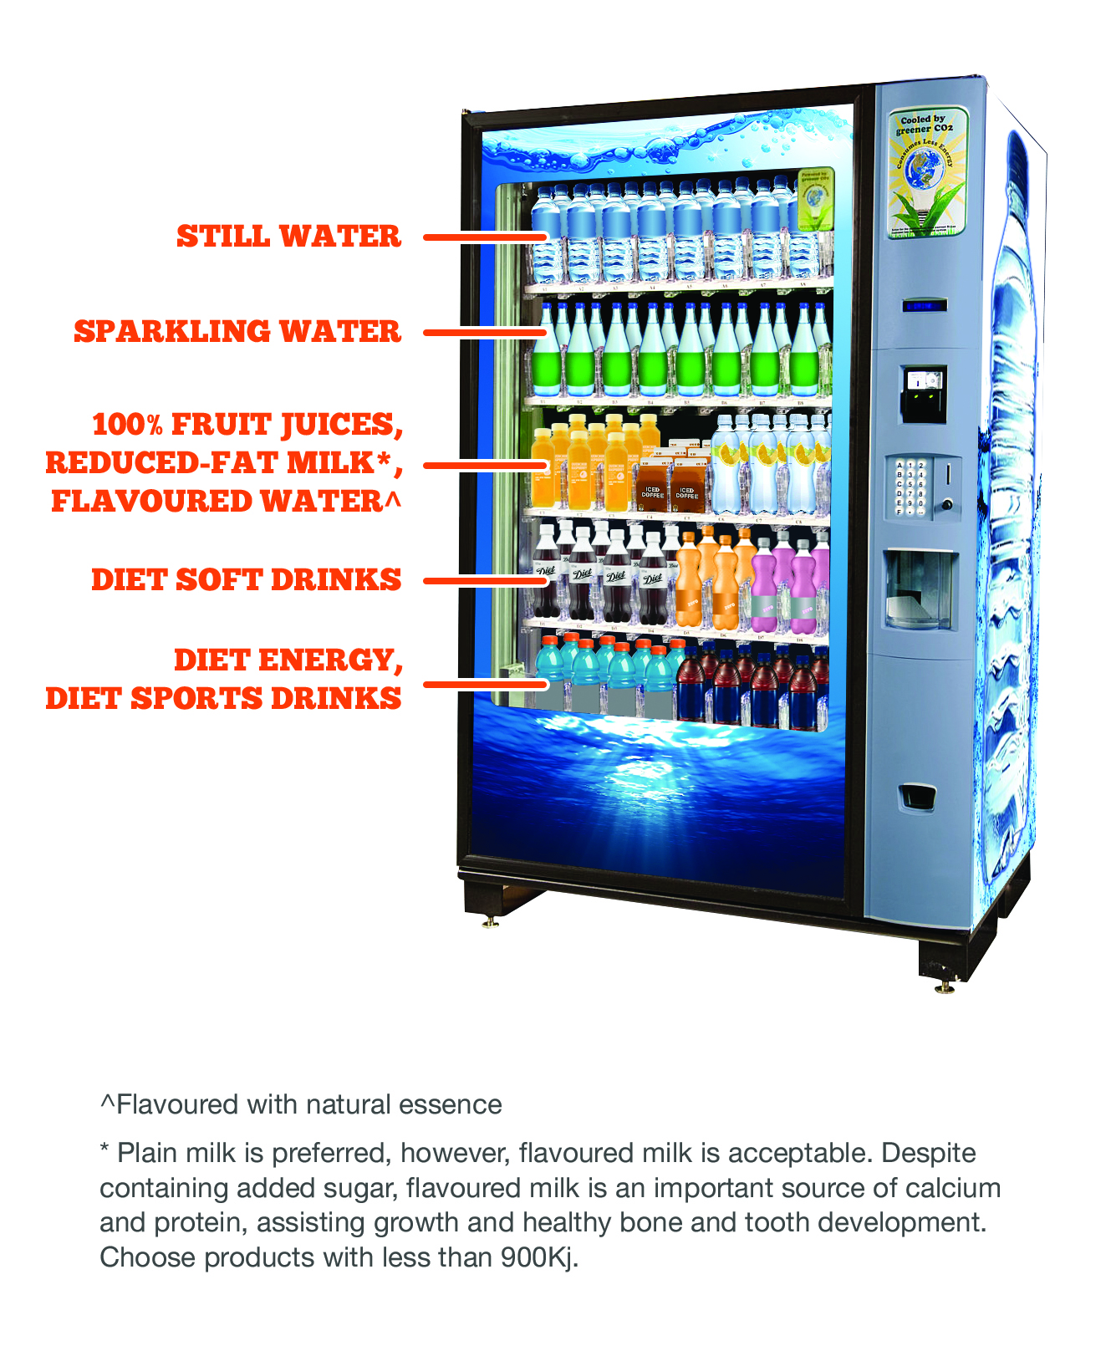
Rethink Sugary Drinks at work
Please update with details of changes your workplace is making/has made
You may notice changes to sugary drinks in your workplace such as:
Less sugary drinks available
More water in vending machines
Higher price for sugary drinks
Smaller bottles and cans
Notes:
You may notice changes to sugary drinks in your workplace such as:
Less sugary drinks available
More water in vending machines
Higher price for sugary drinks
Smaller bottles and cans

Slide 9
Want to learn more?
Visit www.rethinksugarydrink.org.au
Notes:
Want to learn more about sugary drinks? Visit the Rethink Sugary Drink website www.rethinksugarydrink.org.au

